Slide 1
Text Talk
Old Wire Road Elementary School

Slide 2
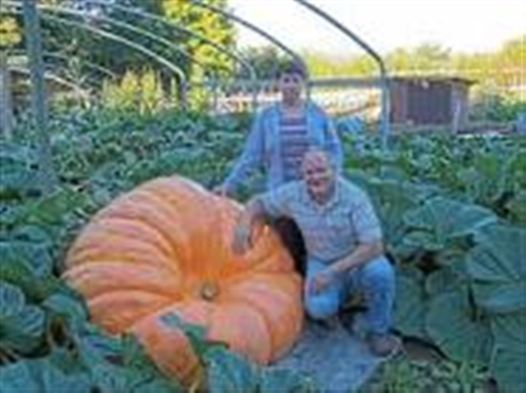
enormous – very large in size
The pumpkin was enormous.

Slide 3
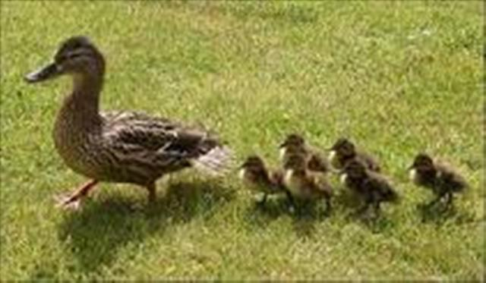
waddled – to walk with side to side steps
The duck and her babies waddled toward the pond.

Slide 4
beckoned – to call or motion to come with your head or hand
My teacher beckoned us to come to the carpet.

Slide 5
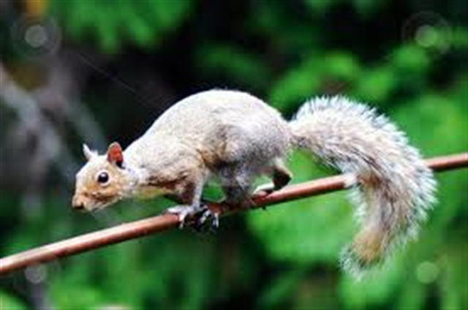
Which picture goes with enormous?

Slide 6
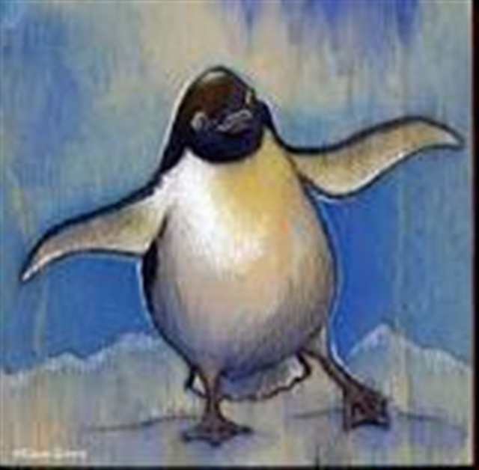
Which picture goes with waddled?

Slide 7
Which picture goes with beckoned?

Slide 8
Which word goes with this picture: enormous, waddled, or beckoned?

Slide 9
Which word goes with this picture: enormous, waddled, or beckoned?

Slide 10
Which word goes with this picture: enormous, waddled, or beckoned?

